Slide 1
Datafrenchy presents data project community March 2024

Slide 2
Agenda
Key Tips
Purpose/Goal
Timeline
Dataset
Q+A’s

Slide 3
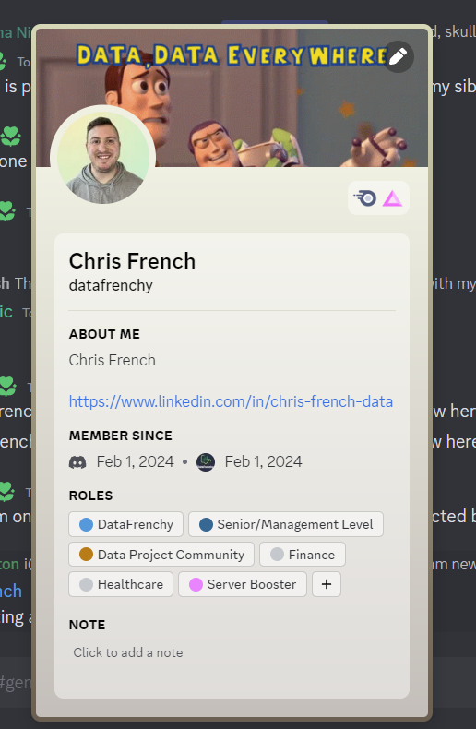
Key Tips
Name
Photo
LinkedIn URL
Roles

Slide 4

Purpose/goal Enhance your technical abilities Create a sense of community & support Work, connect, & learn from others gain confidence AND practice in technical and behavioral skills add to your portfolio

Slide 5
timeline
1st Day of Month: Meetup to discuss the dataset and answer any questions.
Four hours of Office Hours: March 6th, 10th, & 17th
Presentations will take place the last week of March. (Date TBD)

Slide 6
This month’s dataset is…..

Slide 7
Call center dataset
Call Data
Customers
Id: Unique customer-id
Customer_name: The customer’s name
Sentiment: Overall tone of the call
Csat_score: Customer Satisfaction Rating Score (Scale is 1-10, 1 being bad, 10 being perfect.)
Call_timestamp: Date of call
Reason: Category of call purpose
Channel: How the customer connected the call center
Response Time: Was the call within, below, or above service level agreement? (Below = Good, Above = Bad)
Call Duration: Length of call in minutes
Call Center: Call Cetner Location
Agent_ID: The Agent who took the call
City: City of Customer’s Location
State: State of Customer’s Location
YOB: Years of Business

Slide 8
Situational info
Your manager is trying to understand how the call center is operating. Your job is to focus on the following:
Do we have certain agents who respond to calls in a timely matter? Are any agents having poor response time? What about customer ratings towards them?
Where are our most loyal customers located?
Are there certain call centers that perform well? Not well? Are there certain channels that perform well? Not well?
How do our customers feel about our service?

Slide 9



Best dashboard award
$20 Gift Card!

Slide 10
Q+a’s

